Slide 1

Tutorial on Scikit-Learn & Pytorch Programming
January 28, 2024
Risako Owan
*Created using past TA notebooks

Slide 2
Agenda
Scikit-learn
What is Scikit-Learn?
General Framework & Recipe
Application to Iris Dataset
Pytorch
What is Pytorch?
Tensor
Modules
Data preparation

Slide 3
What is Scikit-Learn (sklearn)?
An open-source machine learning library for Python, providing classical machine learning algorithms and statistical modeling tools.
Pros: Probably the best general ML framework in terms of coverage of algorithms, ease of usability, documentation, and community support.
Cons: Not intended for deep learning; GPU support is limited and experimental

Slide 4
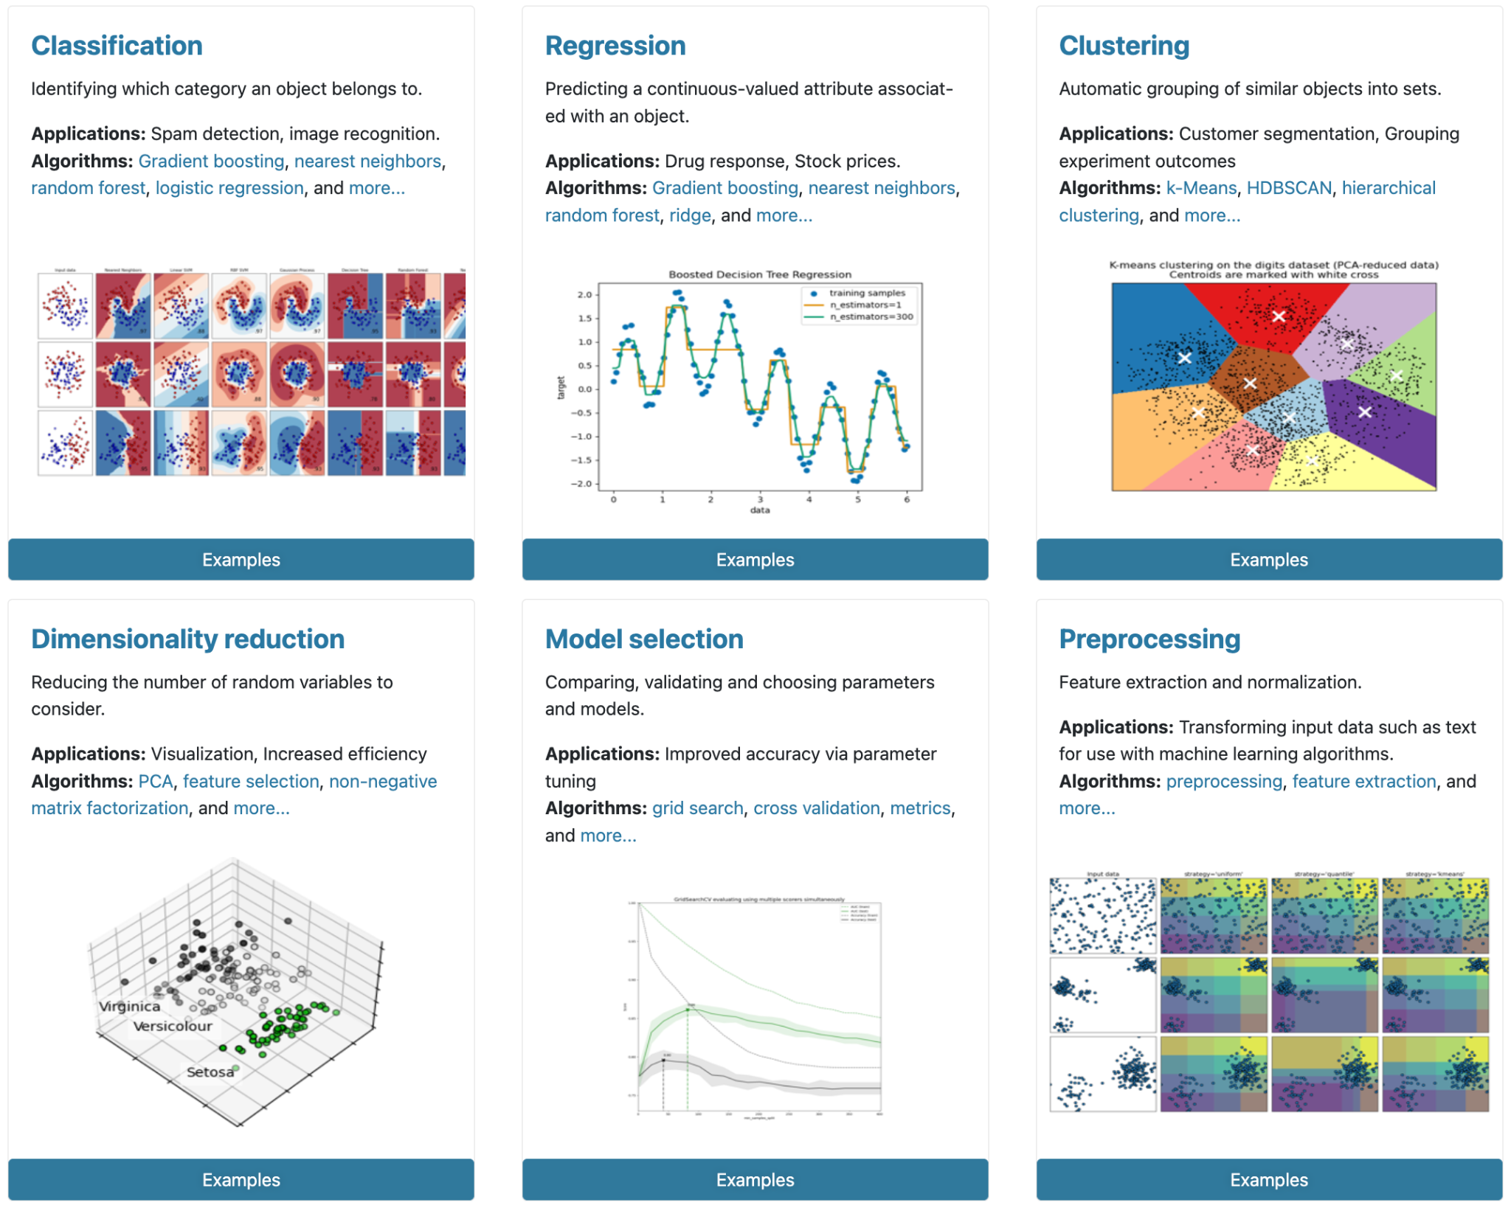
What can Scikit-Learn do?
Generalized linear models
SVMs, kNN, Bayes, Decision Trees, Ensembles
Clustering & density algs.
Cross validation
Grid & random search
Pipelining
Model evaluation
Dataset loading
Dataset transformations

Slide 5
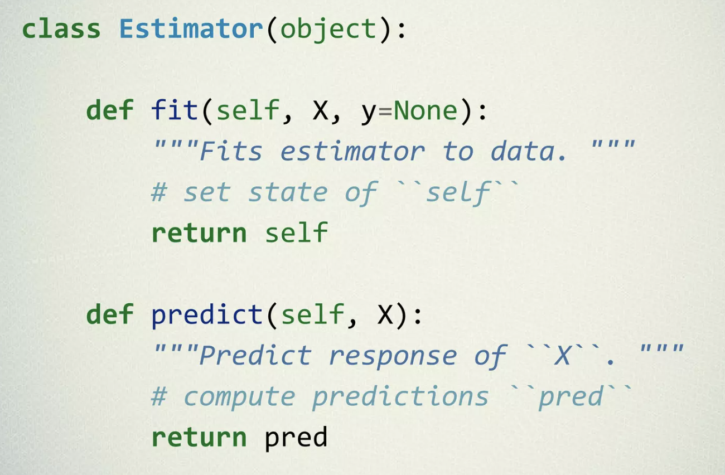
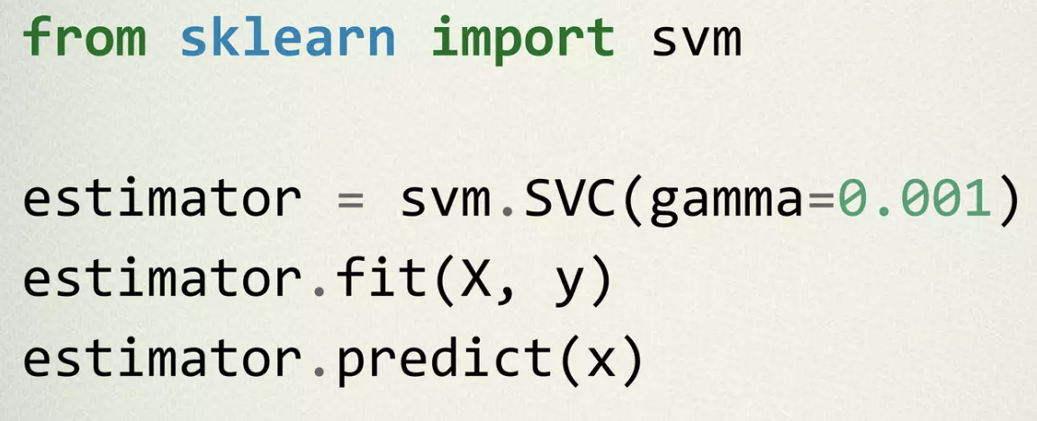
General framework
Object-oriented interface centered around the concept of Estimator:
An estimator is an object that learns from data and can make inferences about new data.
X is usually a 2D numpy array of shape (num_samples, num_features).
y is a 1D array with shape (num_samples,)
fit(X, y) sets the state of the estimator.
predict(X) returns the class or value.

Slide 6
Recipe
Observe the dataset, e.g. plotting the dataset to check for distribution and outliers, counting specific instances, etc.
Preprocess the dataset, if needed, e.g. treating missing values, scaling, normalizing, reducing dimensionality, clustering, etc.
Set up feature matrix, X and target array, y
Choose (“import”) algorithm model class
Set model hyperparameters via arguments to model constructor
“Fit” model to the training data
Apply model to new data (“predict”)
Evaluate the model’s predictions
Let’s apply this recipe to the following dataset:
Iris Dataset

Slide 7
Now let’s head to Notebooks
Classification using Iris Dataset
Classification using Disaster Tweets

Slide 8
What is Pytorch?
https://pytorch.org/
Pytorch: a Python package for deep learning based on torch (Lua, C)
Why use Pytorch?
Integrated with other libraries, e.g., numpy, scipy, pandas
Tensor computations that can be accelerated by GPUs
Predefined layers, loss functions, etc. → useful in designing & training neural networks
Many research papers implement their code in Pytorch

Slide 9
Tensors
Tensor in Pytorch:
“Similar to numpy’s ndarrays but can run on GPUs or other hardware accelerators”
Example:
data = [[1, 2],[3, 4]]
x_data = torch.tensor(data)
np_array = np.array(data)
x_np = torch.from_numpy(np_array) #creating a tensor from np array

Slide 10
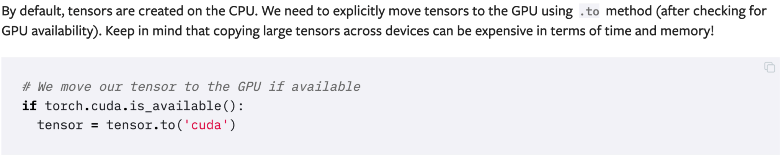
Operations on Tensors

Slide 11
Modules
Module: represents a neural network model’s architecture, parameters, and methods.
It can be anything that inherits from nn.Module:
A single layer
A network
A sub-network
It provides a set of methods that define the module’s behavior, such as the forward method, which computes the output of the module given its inputs.
A module’s forward method is where the actual computation happens

Slide 12
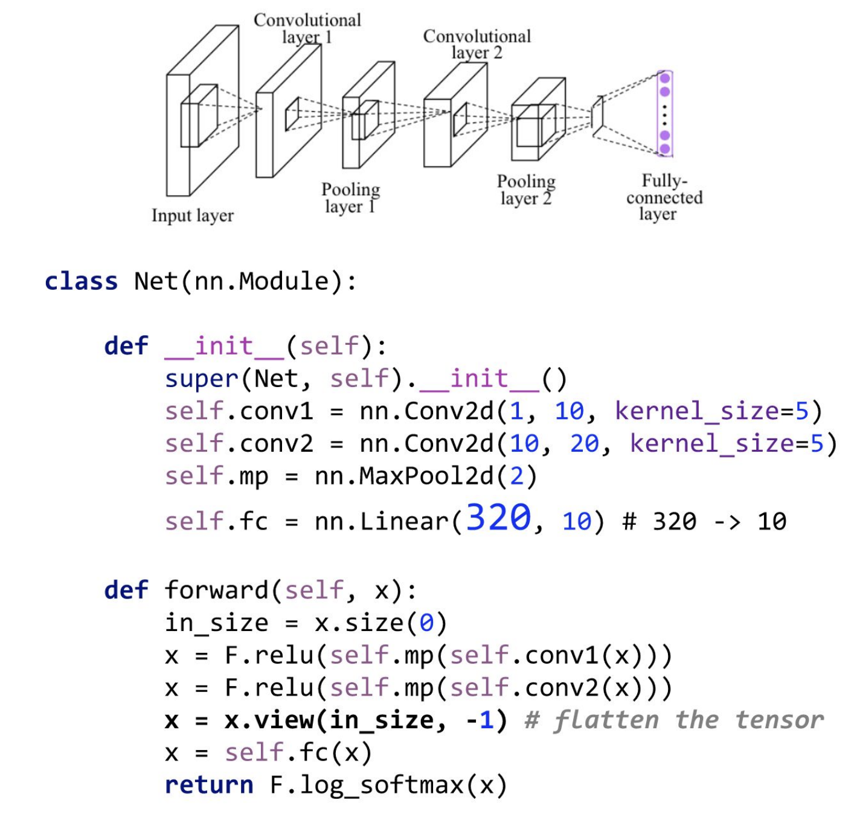
Modules as a network

Slide 13
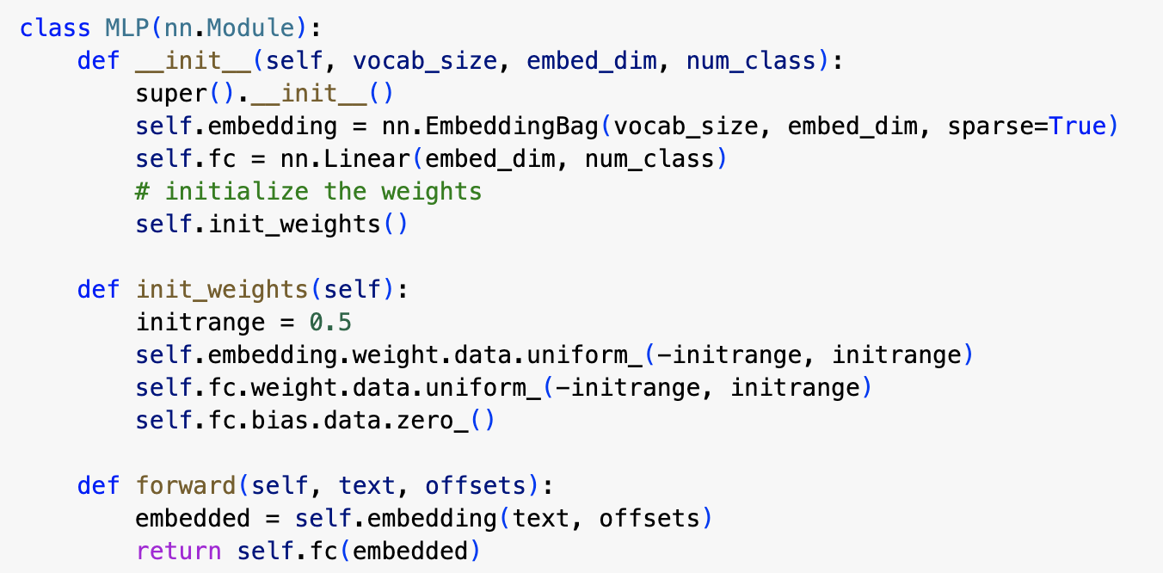
Modules as a network

Slide 14
Recipe
Data preparation
Data loading
Preprocessing
Model design
Pretrained models
Designing your own models
Training strategy
Loss function
Optimizer
Validation
Stopping strategy

Slide 15
Data prep. – Data loading
PyTorch provides two data primitives:
torch.utils.data.DataLoader
torch.utils.data.Dataset
They allow you to use pre-loaded datasets as well as your own data:
Dataset stores the samples and their corresponding labels
DataLoader wraps an iterable around the Dataset to enable easy access to the samples (+ other useful methods like collation and sampling)

Slide 16
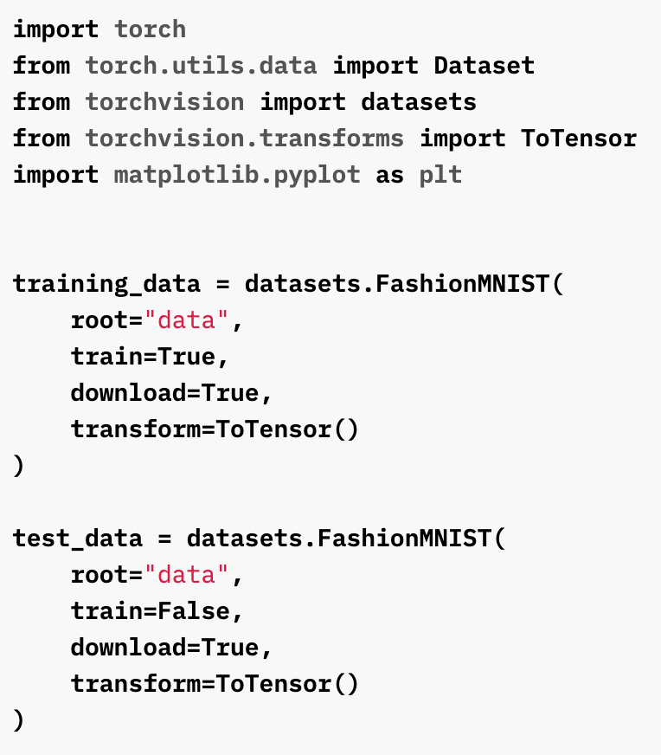
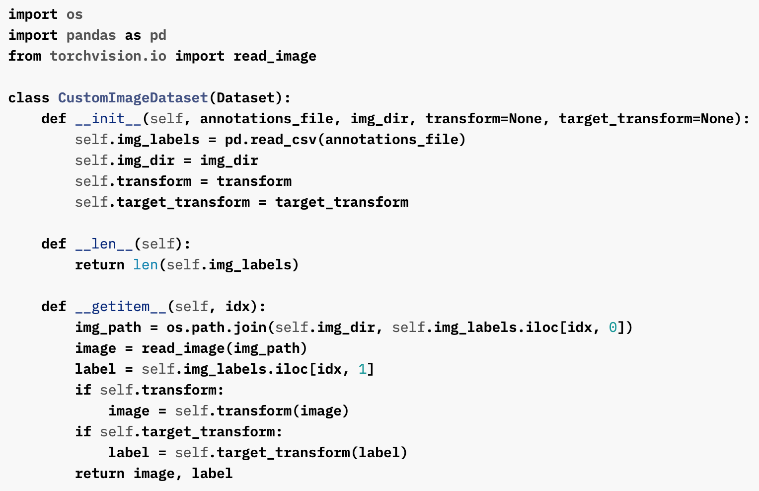
Data prep. – Data loading
Download/read data
Return data length
Return item on the index
Using existing datasets
Creating a custom dataset. Need to implement __init__, __len__, and __getitem__ methods

Slide 17
Data prep. – Preprocessing
Transformation of images may includes:
Cropping
Zooming
Translation
Coloring
etc.
Transformation of texts may includes:
Stop word filtering
Lemmatization
Tokenization
POS tagging
etc.
If the transformation routine takes a long time to complete, it would be better to do it offline, save them, and work with the preprocessed results instead.

Slide 18
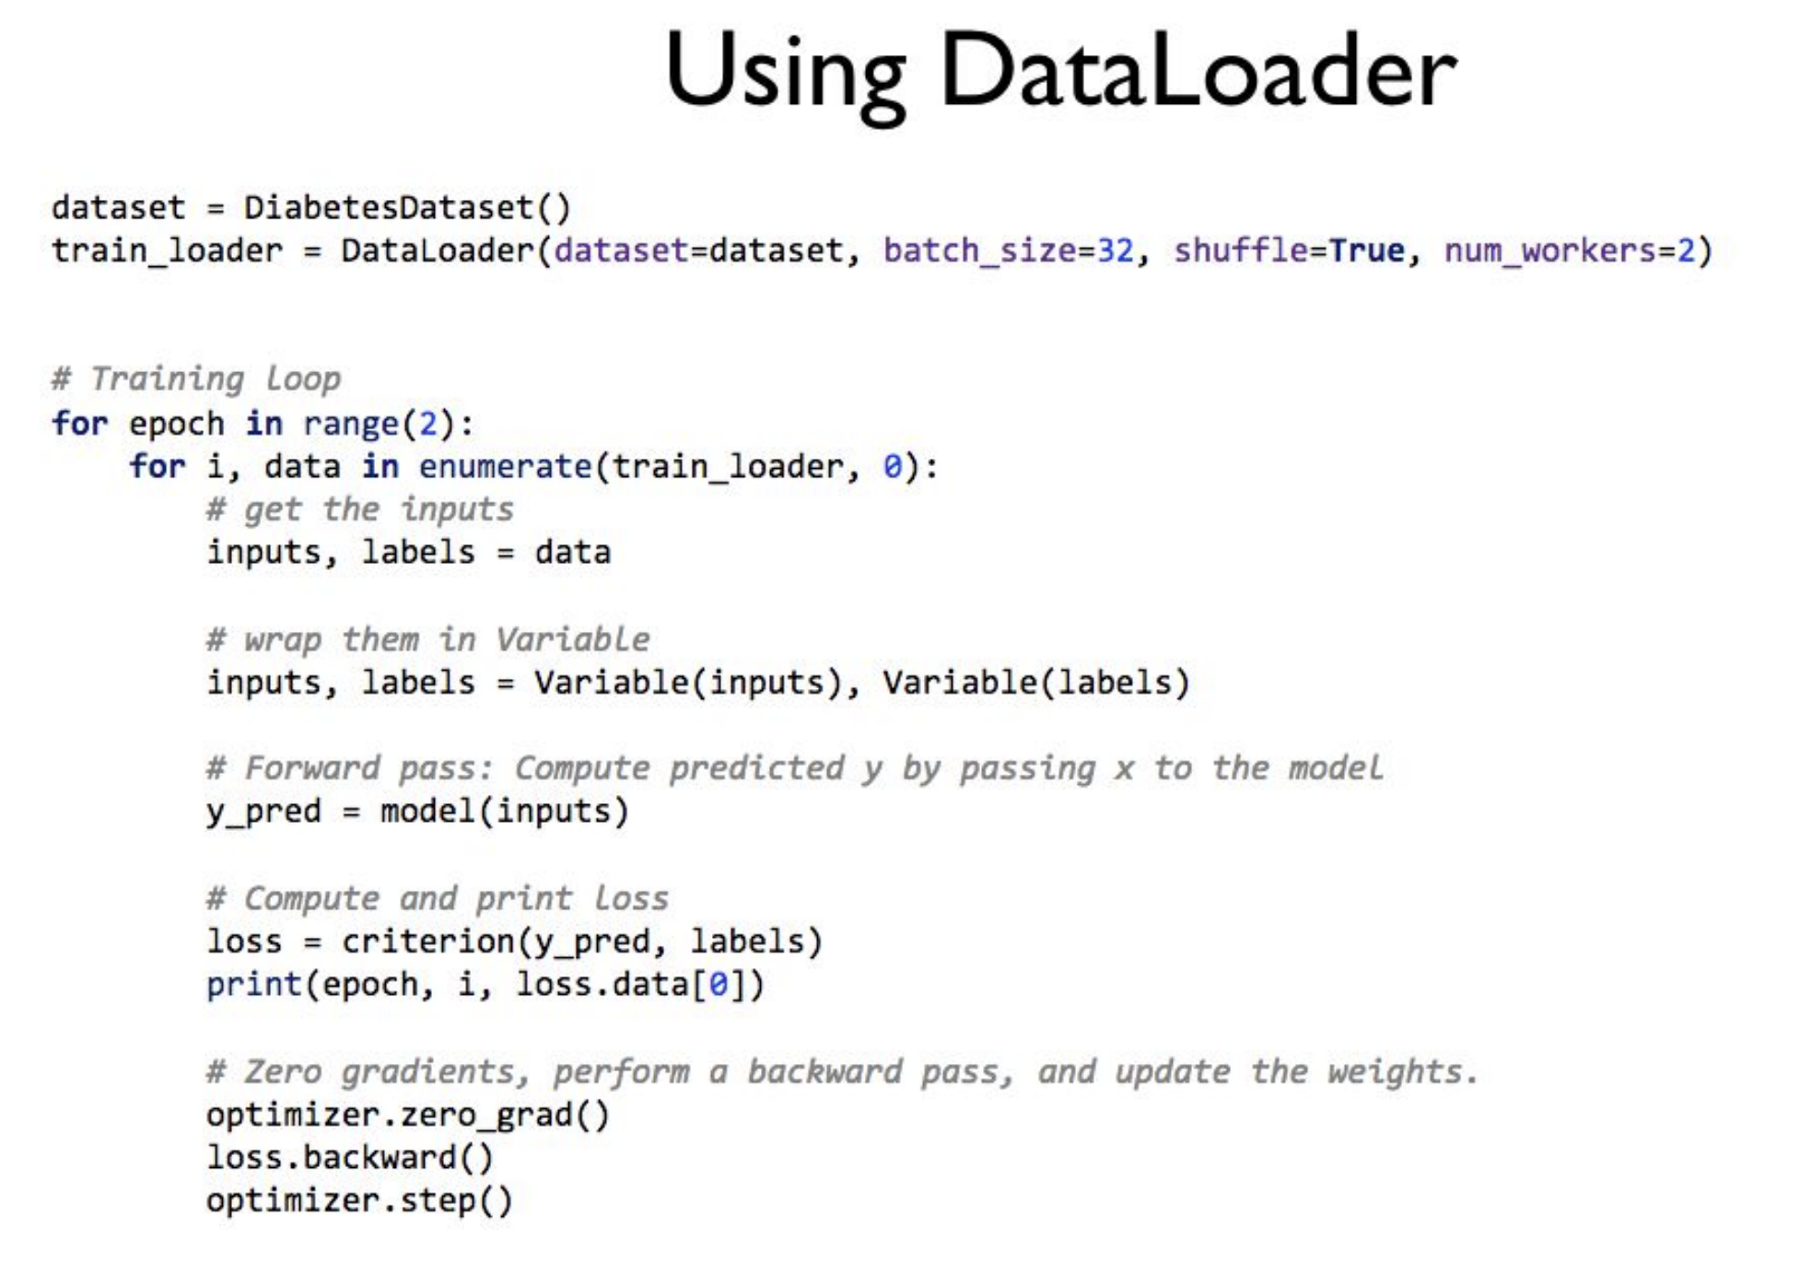
Data prep. – Data loading

Slide 19
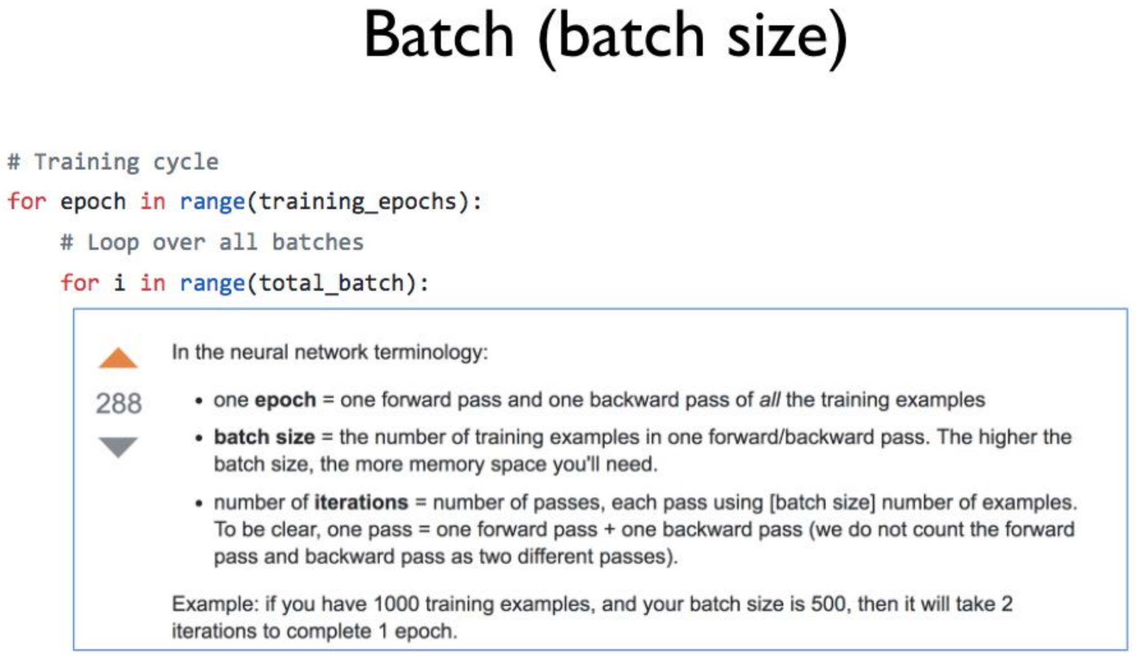
Data prep. – Data loading

Slide 20
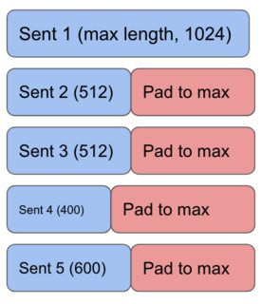
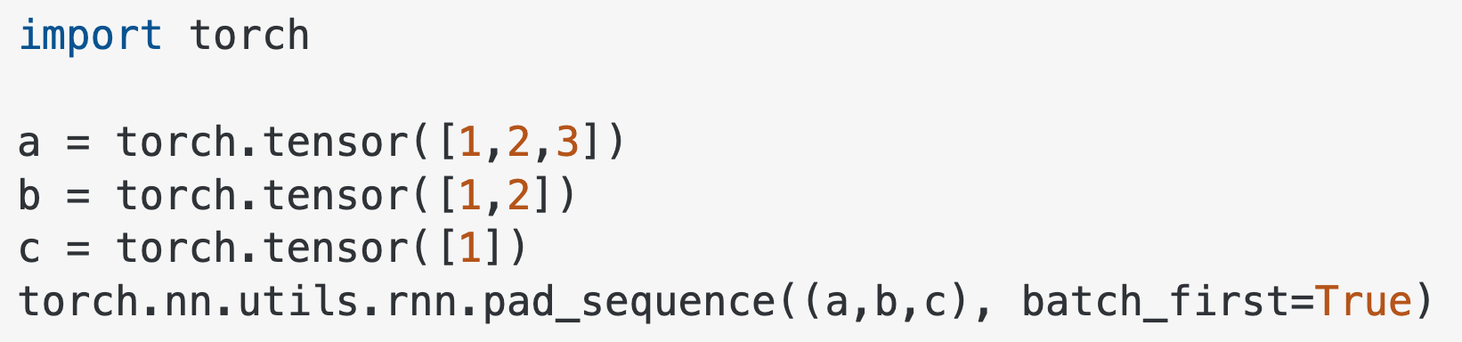
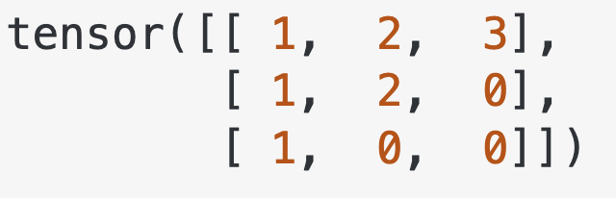
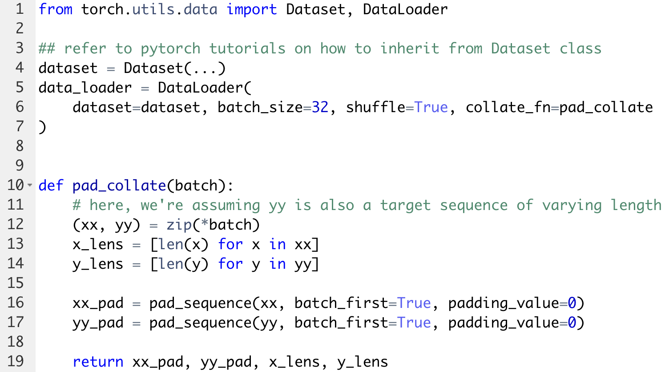
Data prep. – Padding for texts
As each sample of texts may be of varying lengths, when batching, it is required that we need to “pad” the shorter samples with “pad_token.”

Slide 21
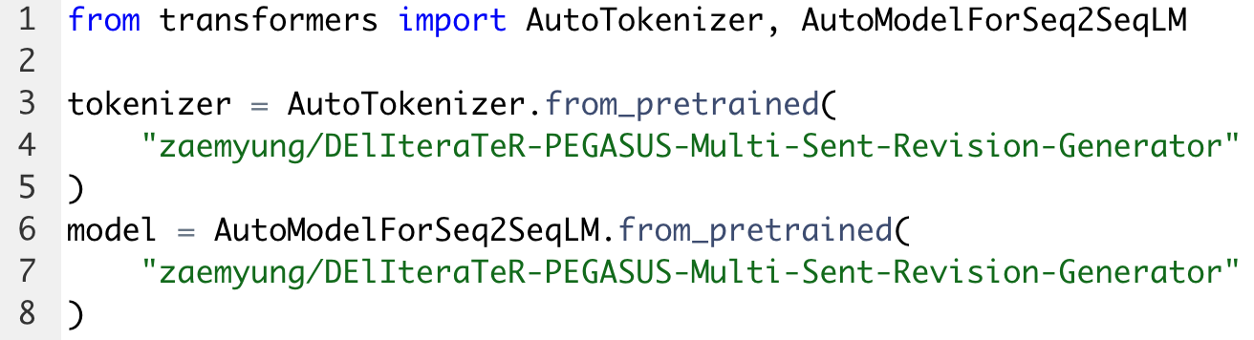
Model design – Pretrained models
You can publish/load your models from torch.hub. However, for NLP, we mostly use HuggingFace Hub:

Slide 22
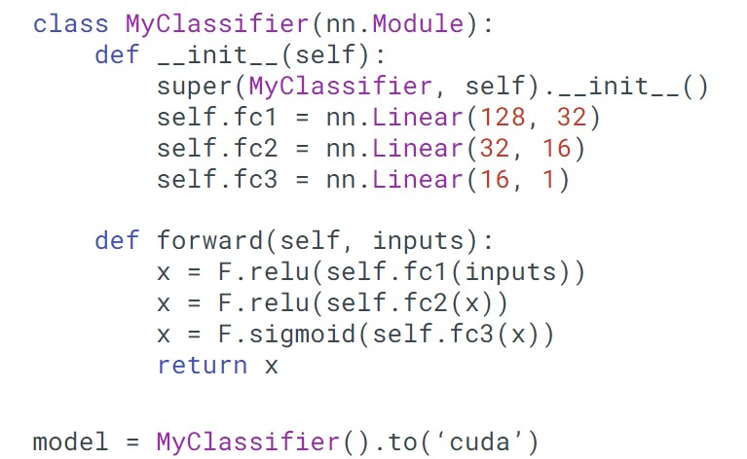
Model design – Custom models
How is the network structured?
The architecture would vary based on if the network we are trying to build is a perceptron or a Recurrent network or any other form of network.
We also define different architecture parameters like the number of layers in the network and the number of neurons in each hidden layer of the fully connected network, and activation functions.

Slide 23
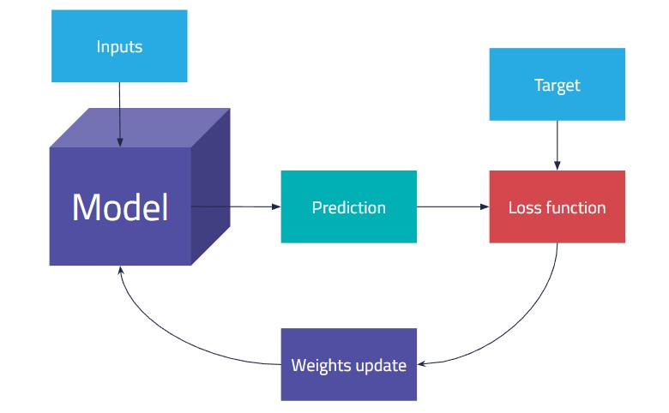
Model training

Slide 24
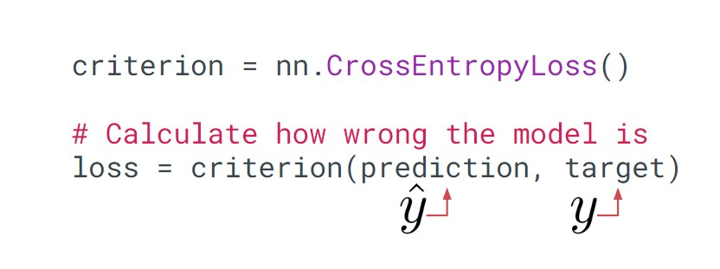
Model training – Loss function

Slide 25
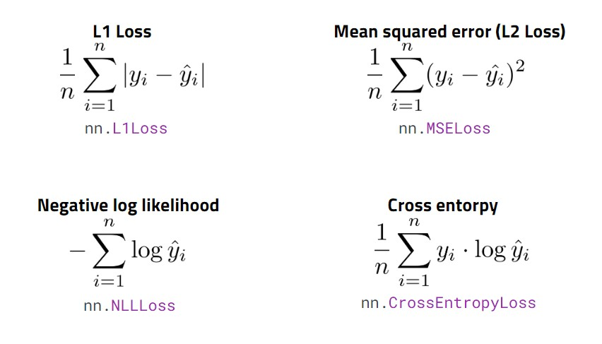
Model training – Loss function

Slide 26
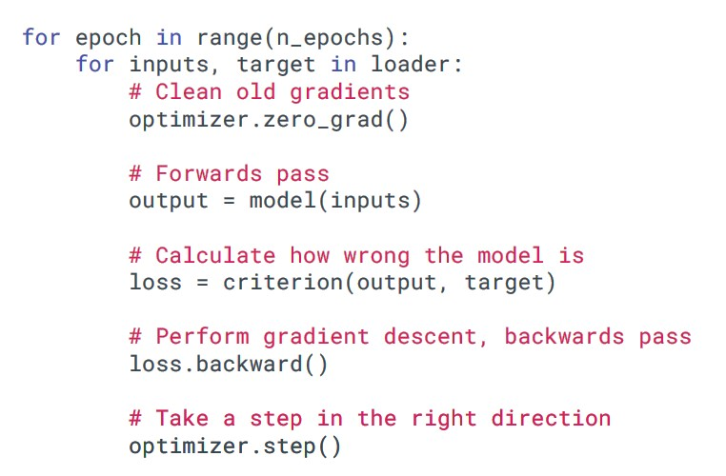
Model training – Optimizer
torch.optim
Adam, Adagrad, Adadelta, SGD etc.
An optimizer takes the parameters we want to update, the learning rate we want to use (and possibly many other hyper-parameters as well!) and performs the updates
optimizer = optim.SGD(model.parameters(), lr=0.01, momentum=0.9)
# optimizer = optim.Adam([var1, var2], lr=0.0001)

Slide 27
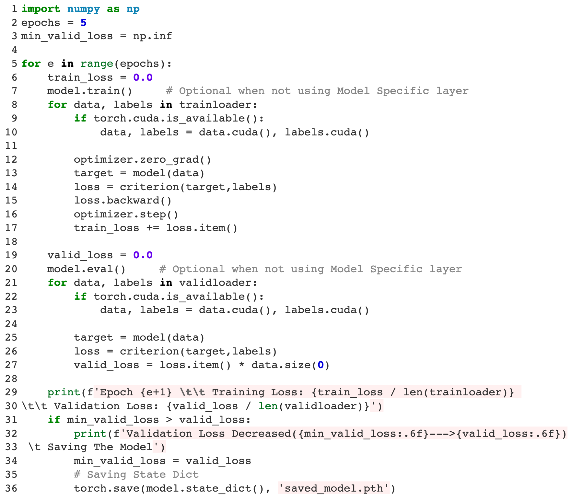
Model training – Validation
By having a separate DataLoader for validation set, we can validate the model being trained after one epoch or certain number of iterations.
Validation set is a held-out dataset that we use to select from multiple checkpoints of the model.
Also, depending on the validation score, we may decide to stop the training early (early stopping).

Slide 28
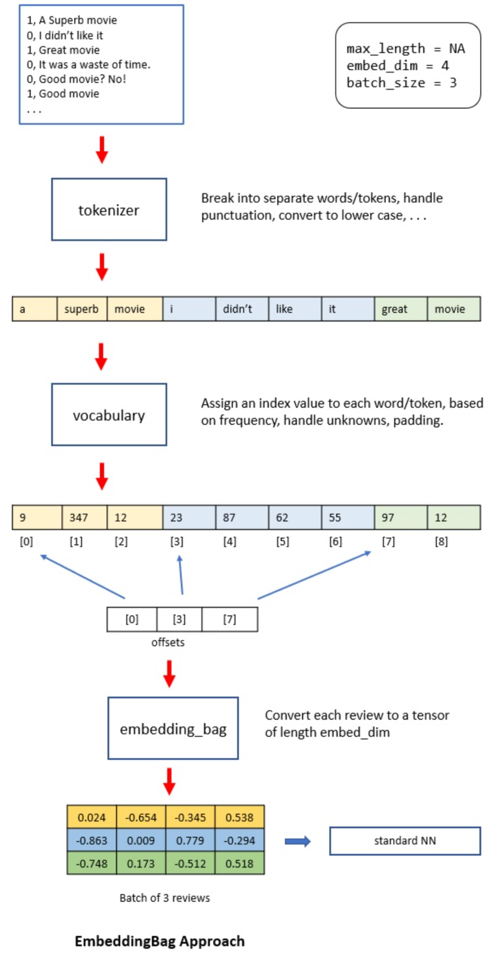
EmbeddingBags
With an EmbeddingBag, you don’t need padding.
You connect the sentences together into an input batch and record where each sentence starts in an offsets array.
With an EmbeggingBag, each sentence is represented by an embedding vector.

Slide 29
Now let’s head to Notebooks
Classification using Iris Dataset
Classification using Disaster Tweets

Slide 30
References
https://scikit-learn.org/stable/index.html
https://www.slideshare.net/BenjaminBengfort/introduction-to-machine-learning-with-scikitlearn
https://datamastery.gitlab.io/slides/scikit-learn.pdf
http://scikit-learn.org/stable/auto_examples/datasets/plot_iris_dataset.html
https://pytorch.org/tutorials/beginner/basics/tensorqs_tutorial.html
https://miguelgfierro.com/blog/2022/an-analysis-of-the-adoption-of-top-deep-learning-frameworks/
http://cs231n.stanford.edu/2021/slides/2021/discussion_4_pytorch.pdf
https://web.cs.ucdavis.edu/~yjlee/teaching/ecs289g-winter2018/Pytorch_Tutorial.pdf
https://beerensahu.wordpress.com/2018/03/21/pytorch-tutorial-lesson-2-variable/
https://towardsdatascience.com/getting-started-with-pytorch-part-1-understanding-how-automatic-differentiation-works-5008282073ec
https://jalammar.github.io/illustrated-transformer/
https://nlp.seas.harvard.edu/2018/04/03/attention.html
https://www.geeksforgeeks.org/training-neural-networks-with-validation-using-pytorch/
https://pytorch.org/tutorials/beginner/saving_loading_models.html
https://saturncloud.io/blog/what-are-embeddings-in-pytorch-and-how-to-use-them/
Previous tutorial slides: https://docs.google.com/presentation/d/1qpd-Ej15fOszLS8Pzl2vIccrW_Qkfcrc3-4wqOtkzww/edit#slide=id.g27c35a91bda_0_0
https://jamesmccaffrey.wordpress.com/2021/04/14/explaining-the-pytorch-embeddingbag-layer/

Slide 31
Appendix

Slide 32
Scikit-learn

Slide 33
Categories of ML algorithms
Supervised (e.g. classification, regression)
Learn from a training set of labeled data – the supervisor
Generalize to unseen instances
Unsupervised (e.g. clustering, dimensionality reduction)
Learn from a set of unlabeled data
Place an unseen instance into appropriate group
Infer rules describing the groups
Reinforcement Learning (e.g. Alphago, GPT4, autonomous driving)
Learn from a history of trial-and-error exploration
Output is a policy – a mapping from states to actions (or probability distributions over actions)
Classification using supervised learning methods makes up the lion’s share of machine learning.

Slide 34
Data representation
The basic supervised learning setup in Scikit-Learn is:
Feature Matrix, X
Rows are instances
Columns are features
(num_samples, num_features)
Target array, y
An array of len(rows) containing the training labels for each instance
We can easily obtain these with a Pandas DataFrame

Slide 35
What can Scikit-Learn do?
Generalized linear models
SVMs, kNN, Bayes, Decision Trees, Ensembles
Clustering & density algs.
Cross validation
Grid & random search
Pipelining
Model evaluation
Dataset loading
Dataset transformations

Slide 36
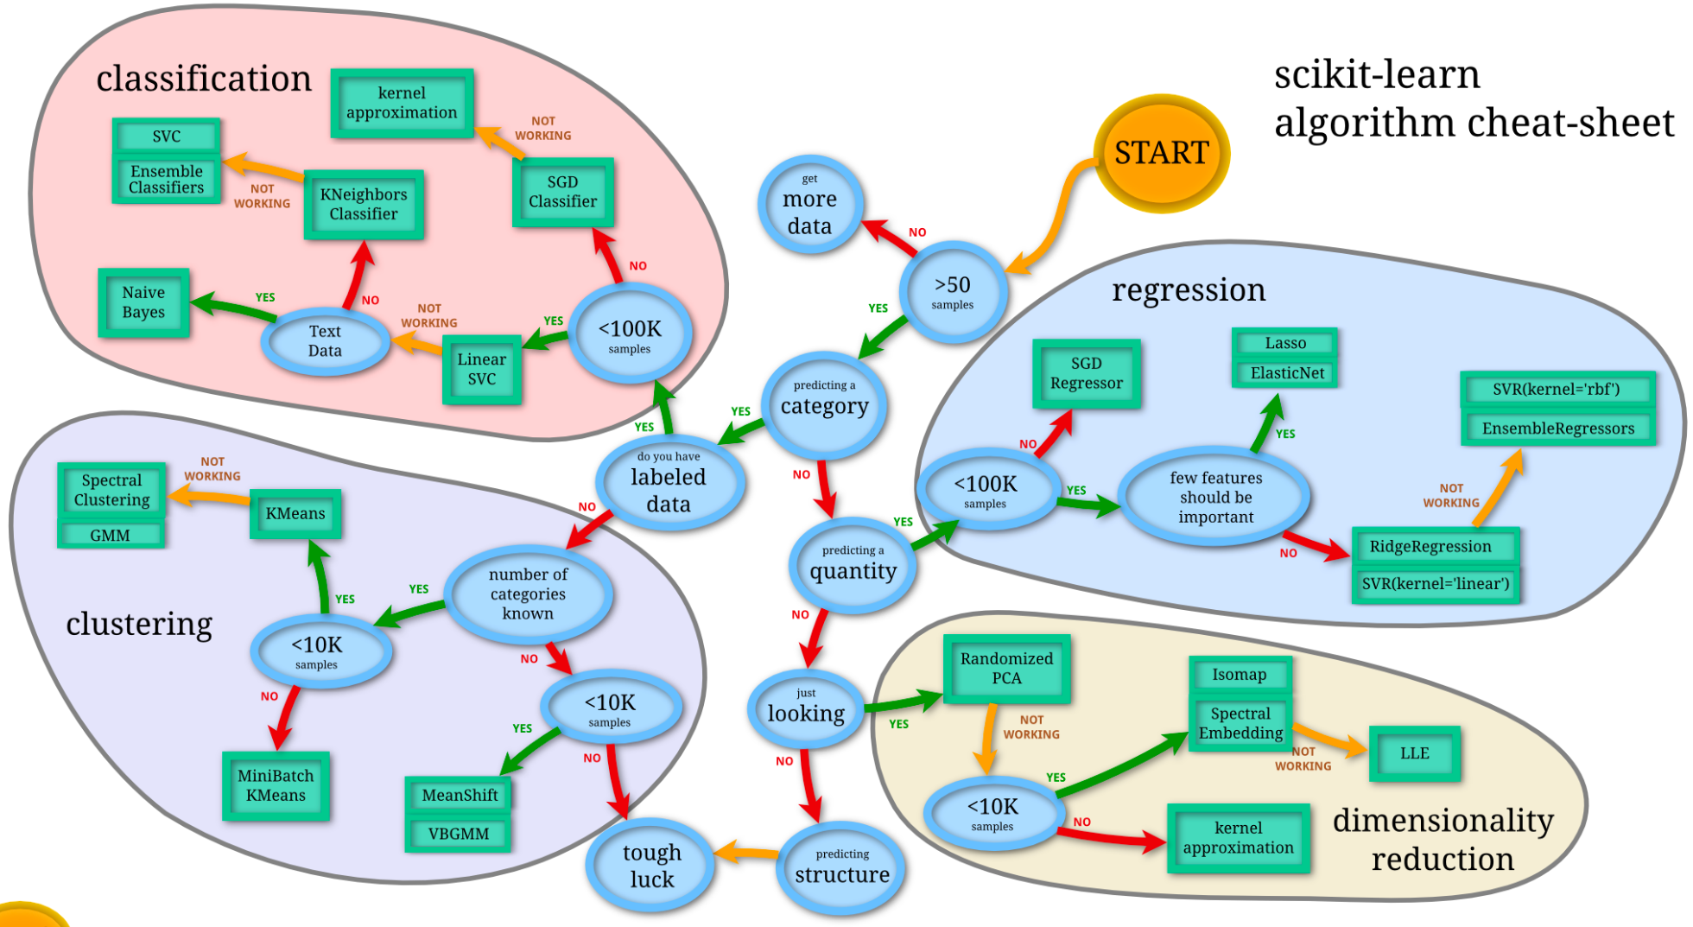
A flowchart guide

Slide 37
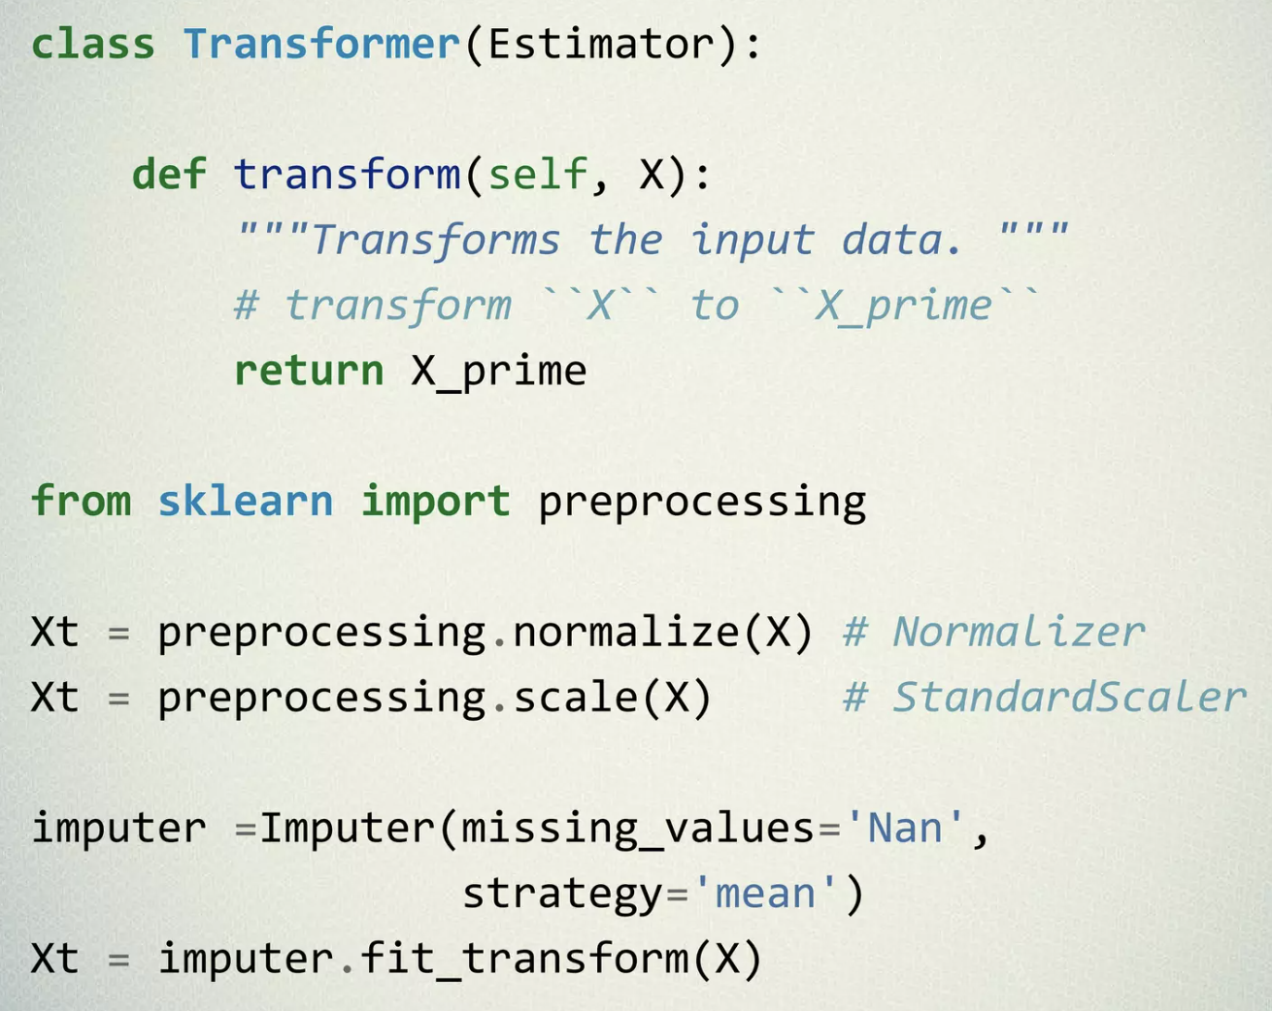
General framework
Transformers are classes that enable data transformations while preprocessing the data for machine learning.
A few examples of transformers in Scikit-Learn are SimpleImputer, MinMaxScaler, OrdinalEncoder, PowerTransformer, CountVectorizer
At times, we may require to perform data transformations that are not predefined.
In such cases, custom transformers come to the rescue.

Slide 38
Pytorch

Slide 39
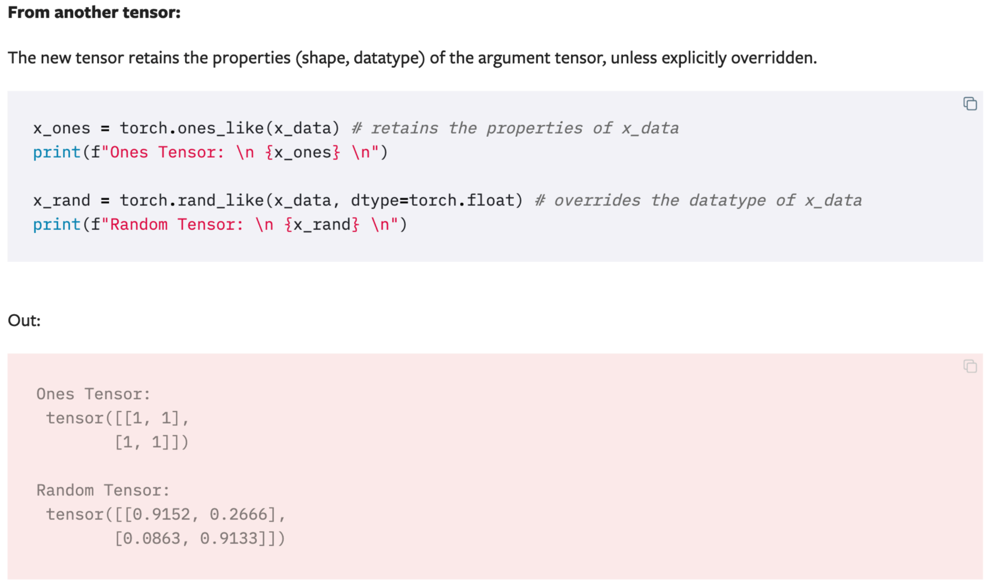
Initializing a Tensor

Slide 40
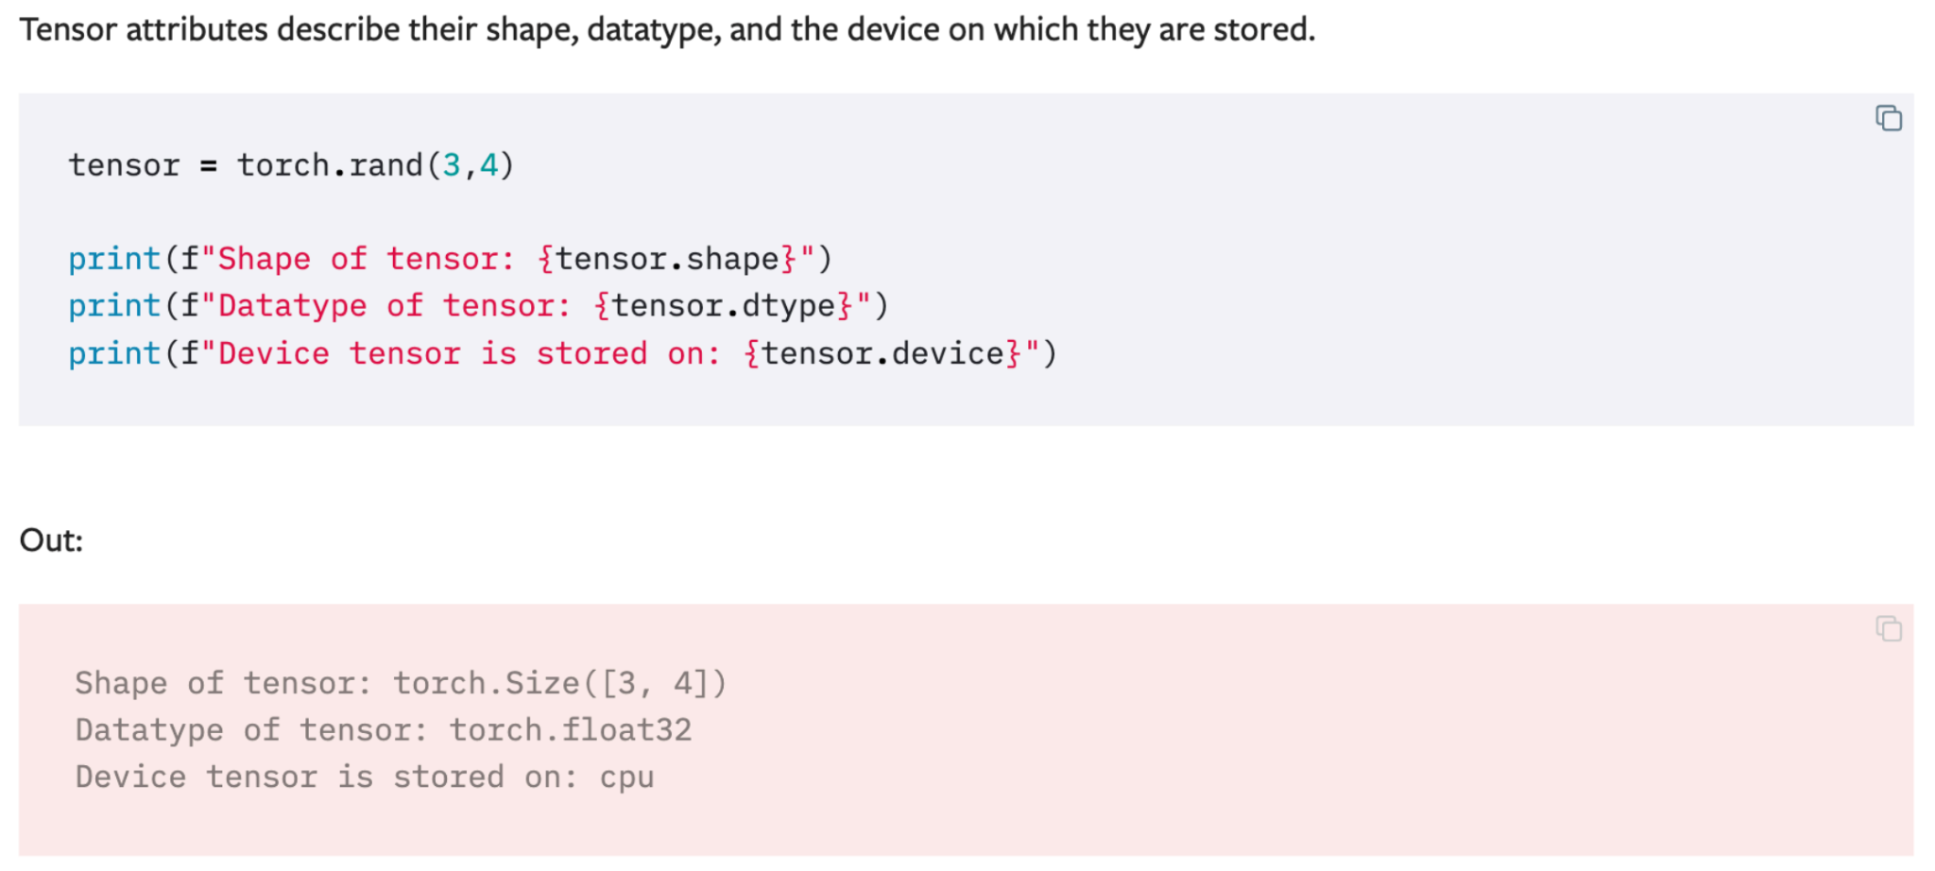
Attributes of a Tensor

Slide 41
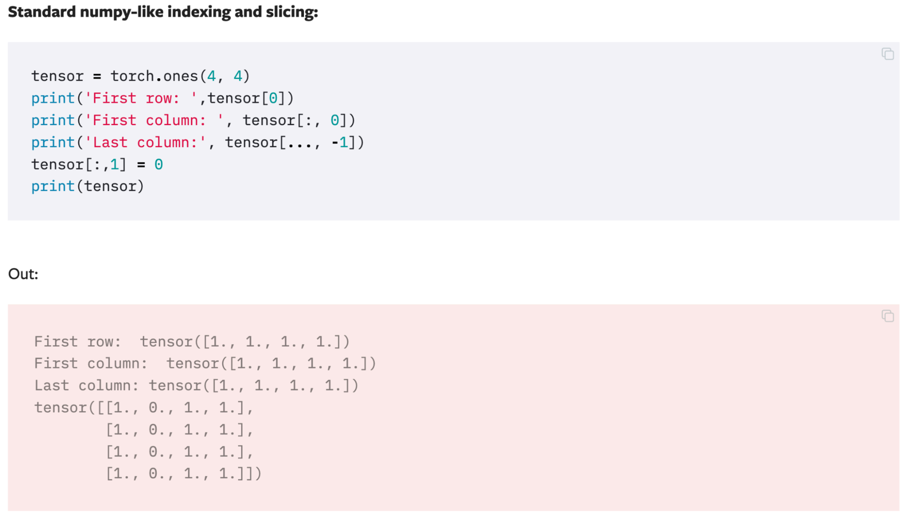
Operations on Tensors

Slide 42
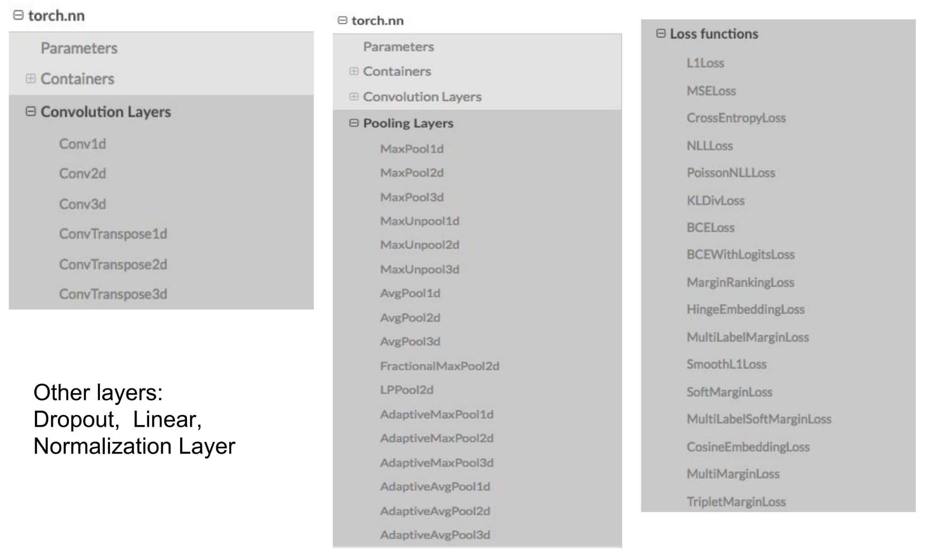
Modules as a single layer

Slide 43
Model saving & loading
There are a few ways to save and load a model.
A recommended way to save & load for inference is:
torch.save(model.state_dict(), PATH)
model = TheModelClass(*args, **kwargs)
model.load_state_dict(torch.load(PATH))
model.eval()
What is a state_dict?
In PyTorch, the learnable parameters (i.e. weights and biases) of an torch.nn.Module model are contained in the model’s parameters (accessed with model.parameters()).
A state_dict is simply a Python dictionary object that maps each layer to its parameter tensor.

Slide 44
Model saving & loading
However, if we want to save & load for further training, we need to save a couple more things:
torch.save({
'epoch': epoch,
'model_state_dict': model.state_dict(),
'optimizer_state_dict': optimizer.state_dict(),
'loss': loss,
...
}, PATH)
model = TheModelClass(*args, **kwargs)
optimizer = TheOptimizerClass(*args, **kwargs)
checkpoint = torch.load(PATH)
model.load_state_dict(checkpoint['model_state_dict'])
optimizer.load_state_dict(checkpoint['optimizer_state_dict'])
epoch = checkpoint['epoch']
loss = checkpoint['loss']
model.eval()
# - or -
model.train()

Slide 45
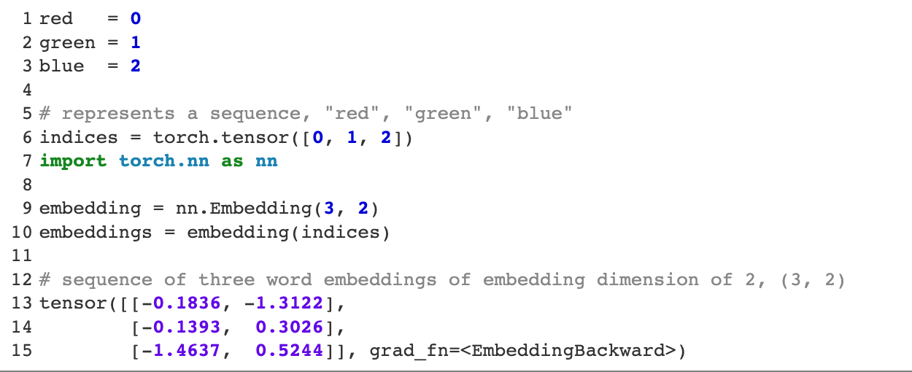
Text representation as Tensors

Slide 46
Model design – Custom models
In PyTorch, a model is represented by a regular Python class that inherits from the Module class.
Two components
__init__(self): it defines the parts that make up the model- in our case, two parameters, a and b
forward(self, x): it performs the actual computation, that is, it outputs a prediction, given the input x

Slide 47
Other useful tools
For logging and checking the progress of model training
TensorBoard
wandb
High-level interface for PyTorch
PyTorch Lightning (for general purposes)
HuggingFace (for NLP, a tutorial will be provided)
Multi-GPU training
Using PyTorch’s Distributed Data Parallel (DDP)
Using HuggingFace’s Accelerate (much easier! recommended)

